Slide 1
جامعة ديالى / كلية الهندسة
قسم الهندسة الإلكترونية
8085 Microprocessor
Lecture 7
المدرس إياد قيس عبد الكريم
2018

Slide 2
جامعة ديالى / كلية الهندسة
قسم الهندسة الإلكترونية
Microprocessor Communication and Bus Timings
Introduction
To understand the functions of various signals of the 8085, we should examine the process of communication (reading from and writing into memory) between the microprocessor and memory and the timings of these signals in relation to the system clock.
The first step in the communication process is reading from memory or fetching an instructor. The steps are as follows:
2018

Slide 3
جامعة ديالى / كلية الهندسة
قسم الهندسة الإلكترونية
Fetching an instructor
Example:
Illustrate the steps and the timing of data flow when the instruction code 0100 1111 (4FH—MOV C, A), stored in location 2005H, is being fetched.
2018

Slide 4
جامعة ديالى / كلية الهندسة
قسم الهندسة الإلكترونية
Solution:
To fetch the byte (4FH), the MPU needs to identify the memory location 2005H and enable, the data flow from memory. This is called the Fetch cycle. The data flow is shown in Figure 3.2, and the timings are explained below. Figure 3.3 shows the timing of how a data byte is transferred from memory to the MPU
2018

Slide 5
جامعة ديالى / كلية الهندسة
قسم الهندسة الإلكترونية
Solution:
It shows five different groups of signals in relation to the system clock. The address bus and data bus are shown as two parallel lines. This is a commonly used practice to Represent a logic levels of groups lines some lines are high and other are low, the crossover of the lines indicates that a new byte information is placed on the bus and a dashed straight line indicate a high impedance state. To fetch a byte the MPU perform the following steps:-
2018

Slide 6
جامعة ديالى / كلية الهندسة
قسم الهندسة الإلكترونية
Solution:
The program counter place the 16 – Bit address on the address bus.
The control unit sends the control signal RD to enable the memory chip.
During two state time the instruction byte (4H) is placed on the data bus on AD0 – AD7 and transferred to the microprocessor.
The byte is placed in the instructor decoder of the microprocessor and the task is carried out according to the instruction.
2018

Slide 7
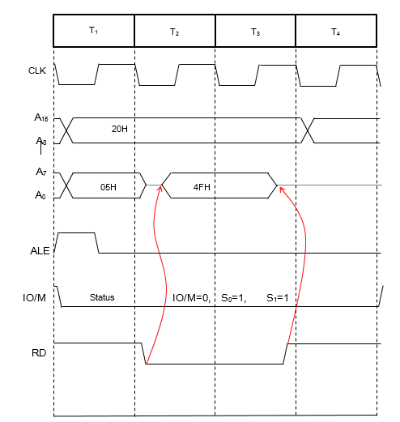
جامعة ديالى / كلية الهندسة
قسم الهندسة الإلكترونية
2018

Slide 8
جامعة ديالى / كلية الهندسة
قسم الهندسة الإلكترونية
Decoding and Executing an Instruction
Example:-
Assume that the accumulator contains data byte 82H, and the instruction MOV C, A (4FH) is fetched. List the steps in decoding and executing the instruction.
2018

Slide 9
جامعة ديالى / كلية الهندسة
قسم الهندسة الإلكترونية
Decoding and Executing an Instruction
Solution:-
To decode and execute the instruction, the following steps are performed.
The contents of the data bus (4F) are placed in the instruction register and decoded.
Contents of the accumulator (82H) are transferred to the temporary register in the ALU.
The contents of the temporary register are transferred to register C.
2018

Slide 10
شكراً لإصغائكم ...
أسئلة ؟
2018

